Slide 1


Chapter 1
Introduction
A note on the use of these Powerpoint slides:
We’re making these slides freely available to all (faculty, students, readers). They’re in PowerPoint form so you see the animations; and can add, modify, and delete slides (including this one) and slide content to suit your needs. They obviously represent a lot of work on our part. In return for use, we only ask the following:
Computer Networking: A Top Down Approach
If you use these slides (e.g., in a class) that you mention their source (after all, we’d like people to use our book!)
If you post any slides on a www site, that you note that they are adapted from (or perhaps identical to) our slides, and note our copyright of this material.
Thanks and enjoy! JFK/KWR
All material copyright 1996-2016
J.F Kurose and K.W. Ross, All Rights Reserved
7th edition
Jim Kurose, Keith Ross
Pearson/Addison Wesley
April 2016
Introduction
1-1

Slide 2
Chapter 1: introduction
our goal:
get “feel” and terminology
more depth, detail later in course
approach:
  use Internet as example
overview:
what’s the Internet?
what’s a protocol?
network edge; hosts, access net, physical media
network core: packet/circuit switching, Internet structure
performance: loss, delay, throughput
security
protocol layers, service models
history
Introduction
1-2
Notes:
2

Slide 3
Chapter 1: roadmap
  1.1 what is the Internet?
  1.2 network edge
    end systems, access networks, links
  1.3 network core
    packet switching, circuit switching, network structure
  1.4 delay, loss, throughput in networks
  1.5 protocol layers, service models
  1.6 networks under attack: security
  1.7 history
Introduction
1-3

Slide 4




















What’s the Internet: “nuts and bolts” view
PC
billions of connected computing devices:
  hosts = end systems
  running network apps
mobile network
server
wireless
laptop
global ISP
smartphone
home
network
communication links
  fiber, copper, radio, satellite
  transmission rate: bandwidth
regional ISP
wireless
links
wired
links
packet switches: forward packets (chunks of data)
  routers and switches
router
institutional
network
Introduction
1-4
Notes:
4

Slide 5


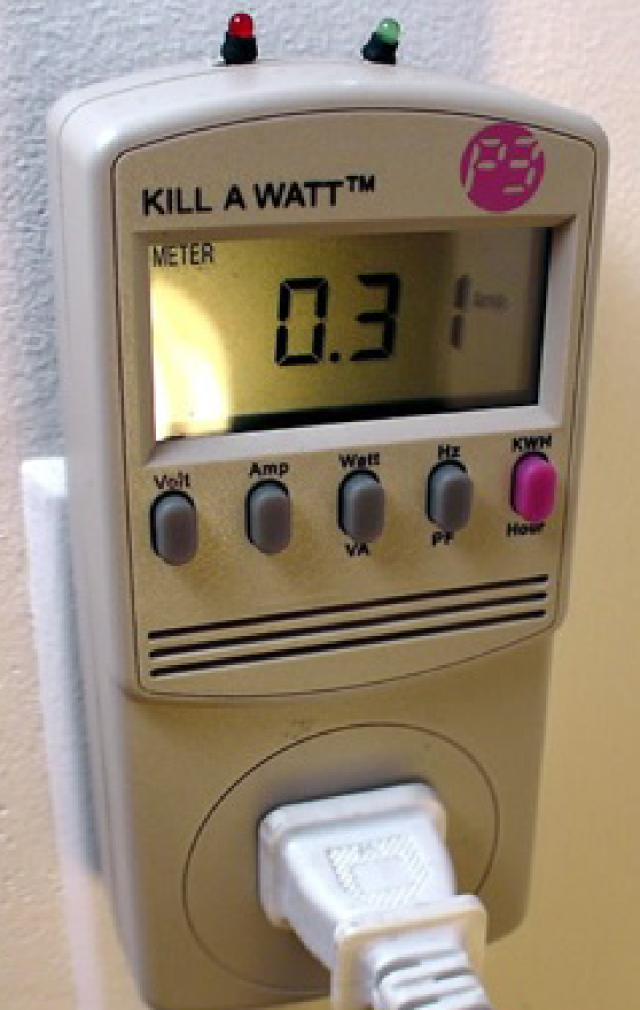



“Fun” Internet-connected devices
Web-enabled toaster +
weather forecaster
IP picture frame
http://www.ceiva.com/
Tweet-a-watt:
monitor energy use
Slingbox: watch,
control cable TV remotely
sensorized,
bed
mattress
Internet
refrigerator
Internet phones
Introduction
1-5
Notes:
5

Slide 6
What’s the Internet: “nuts and bolts” view
Internet: “network of networks”
  Interconnected ISPs
protocols control sending, receiving of messages
  e.g., TCP, IP, HTTP, Skype, 802.11
Internet standards
  RFC: Request for comments
  IETF: Internet Engineering Task Force
mobile network
global ISP
home
network
regional ISP
institutional
network
Introduction
1-6
Notes:
6

Slide 7
What’s the Internet: a service view
mobile network
infrastructure that provides services to applications:
  Web, VoIP, email, games, e-commerce, social nets, …
provides programming interface to apps
  hooks that allow sending and receiving app programs to “connect” to Internet
  provides service options, analogous to postal service
global ISP
home
network
regional ISP
institutional
network
Introduction
1-7
Notes:
7

Slide 8
What’s a protocol?
human protocols:
“what’s the time?”
“I have a question”
introductions
… specific messages sent
… specific actions taken when messages received, or other events
network protocols:
machines rather than humans
all communication activity in Internet governed by protocols
protocols define format, order of messages sent and received among network entities, and actions taken on message transmission, receipt
Introduction
1-8

Slide 9



What’s a protocol?
a human protocol and a computer network protocol:
Hi
TCP connection
request
Hi
TCP connection
response
Got the
time?
Get http://www.awl.com/kurose-ross
2:00
<file>
time
Q: other human protocols?
Introduction
1-9

Slide 10
Chapter 1: roadmap
  1.1 what is the Internet?
  1.2 network edge
    end systems, access networks, links
  1.3 network core
    packet switching, circuit switching, network structure
  1.4 delay, loss, throughput in networks
  1.5 protocol layers, service models
  1.6 networks under attack: security
  1.7 history
Introduction
1-10

Slide 11
A closer look at network structure:
network edge:
  hosts: clients and servers
  servers often in data centers
mobile network
global ISP
access networks, physical media: wired, wireless communication links
home
network
regional ISP
network core:
  interconnected routers
  network of networks
institutional
network
Introduction
1-11

Slide 12
Access networks and physical media
Q: How to connect end systems to edge router?
residential access nets
institutional access networks (school, company)
mobile access networks
keep in mind:
bandwidth (bits per second) of access network?
shared or dedicated?
Introduction
1-12
Notes:
12

Slide 13

Access network: digital subscriber line (DSL)
central office
telephone
network
DSL
modem
splitter
DSLAM
ISP
voice, data transmitted
at different frequencies over
dedicated line to central office
DSL access
multiplexer
  use existing telephone line to central office DSLAM
    data over DSL phone line goes to Internet
    voice over DSL phone line goes to telephone net
  < 2.5 Mbps upstream transmission rate (typically < 1 Mbps)
  < 24 Mbps downstream transmission rate (typically < 10 Mbps)
Introduction
1-13

Slide 14



Access network: cable network
cable headend
…
cable
modem
splitter
C
O
N
T
R
O
L
V
I
D
E
O
V
I
D
E
O
V
I
D
E
O
V
I
D
E
O
V
I
D
E
O
V
I
D
E
O
D
A
T
A
D
A
T
A
1
2
3
4
5
6
7
8
9
Channels
frequency division multiplexing: different channels transmitted
in different frequency bands
Introduction
1-14

Slide 15
Access network: cable network
cable headend
…
cable
modem
splitter
CMTS
cable modem
termination system
data, TV transmitted at different
frequencies over shared cable
distribution network
ISP
HFC: hybrid fiber coax
  asymmetric: up to 30Mbps downstream transmission rate, 2 Mbps upstream transmission rate
network of cable, fiber attaches homes to ISP router
  homes share access network to cable headend
  unlike DSL, which has dedicated access to central office
Introduction
1-15

Slide 16
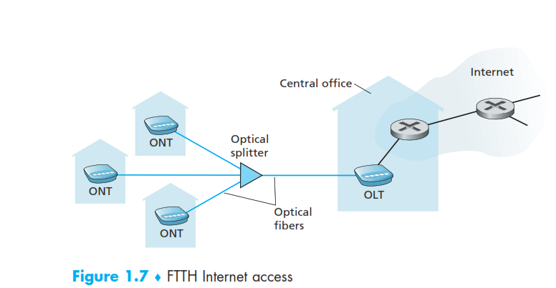
Fiber to the home (FTTH)
Provide an optical fiber path from the CO directly to the home.
Active optical networks (AONs) and passive optical networks (PONs).
Optical network terminator (ONT)
Optical line terminator (OLT)
Introduction
1-16

Slide 17
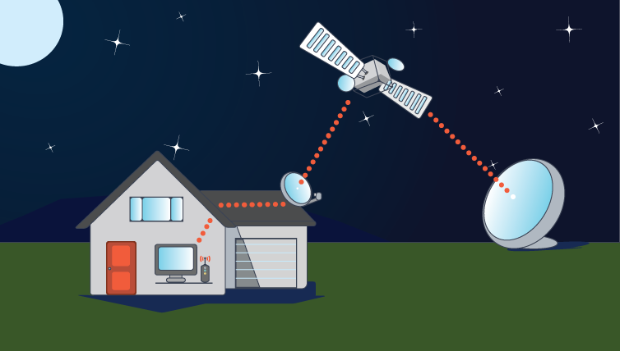
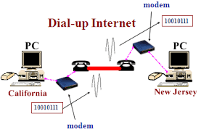
Two other access network technologies
A satellite link can be used to connect a residence to the Internet at speeds of more than 1 Mbps; StarBand and HughesNet are two such satellite access providers.
Dial-up access over traditional phone lines is based on the same model as DSL—a home modem connects over a phone line to a modem in the ISP. (slow at 56 kbps)
Introduction
2-17

Slide 18







Access network: home network
wireless
devices
to/from headend or central office
often combined
in single box
cable or DSL modem
wireless access
point (54 Mbps)
router, firewall, NAT
wired Ethernet (1 Gbps)
Introduction
1-18

Slide 19









Enterprise access networks (Ethernet)
institutional link to
ISP (Internet)
institutional router
Ethernet
switch
institutional mail,
web servers
typically used in companies, universities, etc.
  10 Mbps, 100Mbps, 1Gbps, 10Gbps transmission rates
  today, end systems typically connect into Ethernet switch
Introduction
1-19

Slide 20








Wireless access networks
shared wireless access network connects end system to router
  via base station aka “access point”
wide-area wireless access
  provided by telco (cellular) operator, 10’s km
  between 1 and 10 Mbps
  3G, 4G: LTE
wireless LANs:
  within building (few ft.)
  802.11b/g/n (WiFi): 11, 54, 450 Mbps transmission rate
to Internet
to Internet
Introduction
1-20

Slide 21

Physical media
bit: propagates between
transmitter/receiver pairs
physical link: what lies between transmitter & receiver
guided media:
  signals propagate in solid media: copper, fiber, coax
unguided media:
  signals propagate freely, e.g., radio
twisted pair (TP)
two insulated copper wires
  Category 5: 100 Mbps, 1 Gbps Ethernet
  Category 6: 10Gbps
Introduction
1-21

Slide 22


Physical media: coax, fiber
coaxial cable:
two concentric copper conductors
bidirectional
broadband:
  multiple channels on cable
  HFC
fiber optic cable:
glass fiber carrying light pulses, each pulse a bit
high-speed operation:
  high-speed point-to-point transmission (e.g., 10’s-100’s Gbps transmission rate)
low error rate:
  repeaters spaced far apart
  immune to electromagnetic noise
Introduction
1-22

Slide 23
Physical media: radio
signal carried in electromagnetic spectrum
no physical “wire”
bidirectional
propagation environment effects:
  reflection
  obstruction by objects
  interference
radio link types:
terrestrial microwave
  e.g. up to 45 Mbps channels
LAN (e.g., WiFi)
  54 Mbps
wide-area (e.g., cellular)
  4G cellular: ~ 10 Mbps
satellite
  Kbps to 45Mbps channel (or multiple smaller channels)
  270 msec end-end delay
  geosynchronous versus low altitude
Introduction
1-23
Notes:
23

Slide 24
Chapter 1: roadmap
  1.1 what is the Internet?
  1.2 network edge
    end systems, access networks, links
  1.3 network core
    packet switching, circuit switching, network structure
  1.4 delay, loss, throughput in networks
  1.5 protocol layers, service models
  1.6 networks under attack: security
  1.7 history
Introduction
1-24
Notes:
24

Slide 25









The network core
mesh of interconnected routers
packet-switching: hosts break application-layer messages into packets
  forward packets from one router to the next, across links on path from source to destination
  each packet transmitted at full link capacity
Introduction
1-25

Slide 26


Host: sends packets of data
host sending function:
takes application message
breaks into smaller chunks, known as packets, of length L bits
transmits packet into access network at transmission rate R
  link transmission rate, aka link capacity, aka link bandwidth
two packets,
L bits each
2
1
R: link transmission rate
host
packet
transmission
delay
time needed to
transmit L-bit
packet into link
L (bits)
R (bits/sec)
=
=
Introduction
1-26

Slide 27



Packet-switching: store-and-forward
L bits
per packet
source
3
2
1
R bps
R bps
destination
takes L/R seconds to transmit (push out) L-bit packet into link at R bps
store and forward: entire packet must arrive at router before it can be transmitted on next link
one-hop numerical example:
L = 7.5 Mbits
R = 1.5 Mbps
one-hop transmission delay = 5 sec
end-end delay = 2L/R (assuming zero propagation delay)
more on delay shortly …
Introduction
1-27

Slide 28
Packet Switching: queueing delay, loss
R = 100 Mb/s
C
A
D
R = 1.5 Mb/s
B
E
queue of packets
waiting for output link
queuing and loss:
if arrival rate (in bits) to link exceeds transmission rate of link for a period of time:
  packets will queue, wait to be transmitted on link
  packets can be dropped (lost) if memory (buffer) fills up
Introduction
1-28

Slide 29
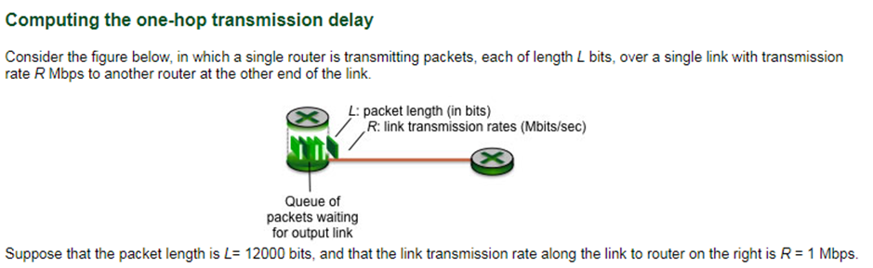

As we know that 1Mbps has 1,000,000 bits per second so in case of (b) 1,000,000/12000=83.333333 packets per sec
Introduction
1-29

Slide 30
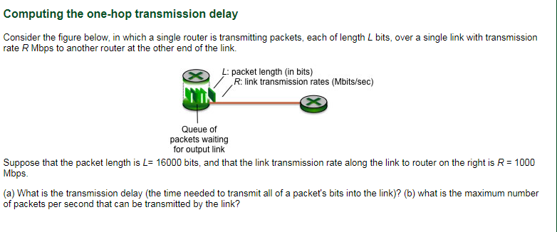
Introduction
1-30

Slide 31
Two key network-core functions
routing: determines source-destination route taken by packets
  routing algorithms
forwarding: move packets from router’s input to appropriate router output
routing algorithm
local forwarding table
header value
output link
0100
0101
0111
1001
3
2
2
1
1
3
2
0111
destination address in arriving
packet’s header
Introduction
1-31

Slide 32
Alternative core: circuit switching
end-end resources allocated to, reserved for “call” between source & dest:
in diagram, each link has four circuits.
  call gets 2nd circuit in top link and 1st circuit in right link.
dedicated resources: no sharing
  circuit-like (guaranteed) performance
circuit segment idle if not used by call (no sharing)
commonly used in traditional telephone networks
Introduction
1-32

Slide 33
Circuit switching: FDM versus TDM
Example:
FDM
4 users
frequency
time
TDM
frequency
time
Introduction
1-33

Slide 34
Packet switching versus circuit switching
packet switching allows more users to use network!
example:
1 Mb/s link
each user:
  100 kb/s when “active”
  active 10% of time
circuit-switching:
  10 users
packet switching:
  with 35 users, probability > 10 active at same time is less than .0004 *
N
users
…..
1 Mbps link
Q: how did we get value 0.0004?
Q: what happens if > 35 users ?
* Check out the online interactive exercises for more examples: http://gaia.cs.umass.edu/kurose_ross/interactive/
Introduction
1-34

Slide 35
Packet switching versus circuit switching
is packet switching a “slam dunk winner?”
great for bursty data
  resource sharing
  simpler, no call setup
excessive congestion possible: packet delay and loss
  protocols needed for reliable data transfer, congestion control
Q: How to provide circuit-like behavior?
  bandwidth guarantees needed for audio/video apps
  still an unsolved problem (chapter 7)
Introduction
1-35

Slide 36
Internet structure: network of networks
End systems connect to Internet via access ISPs (Internet Service Providers)
  residential, company and university ISPs
Access ISPs in turn must be interconnected.
  so that any two hosts can send packets to each other
Resulting network of networks is very complex
  evolution was driven by economics and national policies
Let’s take a stepwise approach to describe current Internet structure
Introduction
1-36

Slide 37
Internet structure: network of networks
Question: given millions of access ISPs, how to connect them together?
…
…
access
net
access
net
access
net
access
net
access
net
access
net
access
net
…
…
access
net
access
net
access
net
access
net
access
net
access
net
…
access
net
access
net
…
access
net
Introduction
1-37

Slide 38
Internet structure: network of networks
Option: connect each access ISP to every other access ISP?
…
…
access
net
access
net
access
net
access
net
access
net
…
…
access
net
access
net
…
connecting each access ISP to each other directly doesn’t scale: O(N²) connections.
…
…
access
net
access
net
…
access
net
access
net
access
net
…
access
net
…
access
net
access
net
…
access
net
Introduction
1-38

Slide 39
Internet structure: network of networks
Option: connect each access ISP to one global transit ISP?
Customer and provider ISPs have economic agreement.
…
…
access
net
access
net
access
net
access
net
access
net
access
net
access
net
…
…
global
ISP
access
net
access
net
access
net
access
net
access
net
access
net
…
access
net
access
net
…
access
net
Introduction
1-39

Slide 40
Internet structure: network of networks
But if one global ISP is viable business, there will be competitors ….
…
…
access
net
access
net
access
net
access
net
access
net
access
net
ISP A
access
net
…
…
access
net
ISP B
access
net
ISP C
access
net
access
net
access
net
access
net
…
access
net
access
net
…
access
net
Introduction
1-40

Slide 41
Internet structure: network of networks
But if one global ISP is viable business, there will be competitors …. which must be interconnected
Internet exchange point
…
…
access
net
access
net
access
net
access
net
access
net
IXP
access
net
access
net
ISP A
…
…
access
net
IXP
ISP B
access
net
ISP C
access
net
access
net
peering link
access
net
access
net
…
access
net
access
net
…
access
net
Introduction
1-41
Notes:
41

Slide 42
Internet structure: network of networks
… and regional networks may arise to connect access nets to ISPs
…
…
access
net
access
net
access
net
access
net
access
net
IXP
access
net
access
net
ISP A
…
…
access
net
IXP
ISP B
access
net
ISP C
access
net
access
net
access
net
regional net
access
net
…
access
net
access
net
…
access
net
Introduction
1-42
Notes:
42

Slide 43
Internet structure: network of networks
… and content provider networks (e.g., Google, Microsoft, Akamai) may run their own network, to bring services, content close to end users
…
…
access
net
access
net
access
net
access
net
access
net
IXP
access
net
access
net
ISP A
…
…
Content provider network
access
net
IXP
ISP B
access
net
ISP C
access
net
access
net
access
net
regional net
access
net
…
access
net
access
net
…
access
net
Introduction
1-43

Slide 44
Internet structure: network of networks
Tier 1 ISP
Tier 1 ISP
Google
IXP
IXP
IXP
Regional ISP
Regional ISP
access
ISP
access
ISP
access
ISP
access
ISP
access
ISP
access
ISP
access
ISP
access
ISP
at center: small # of well-connected large networks
  “tier-1” commercial ISPs (e.g., Level 3, Sprint, AT&T, NTT), national & international coverage
  content provider network (e.g., Google): private network that connects it data centers to Internet, often bypassing tier-1, regional ISPs
Introduction
1-44

Slide 45
Chapter 1: roadmap
  1.1 what is the Internet?
  1.2 network edge
    end systems, access networks, links
  1.3 network core
    packet switching, circuit switching, network structure
  1.4 delay, loss, throughput in networks
  1.5 protocol layers, service models
  1.6 networks under attack: security
  1.7 history
Introduction
1-45

Slide 46
How do loss and delay occur?
packets queue in router buffers
packet arrival rate to link (temporarily) exceeds output link capacity
packets queue, wait for turn
packet being transmitted (delay)
A
B
packets queueing (delay)
free (available) buffers: arriving packets
dropped (loss) if no free buffers
Introduction
1-46

Slide 47
Four sources of packet delay
transmission
A
propagation
B
nodal
processing
queueing
d_{nodal} = d_{proc} + d_{queue} + d_{trans} + d_{prop}
d_{proc}: processing
check bit errors
determine output link
typically < msec
d_{queue}: queueing delay
time waiting at output link for transmission
depends on congestion level of router
Introduction
1-47

Slide 48
Four sources of packet delay
transmission
A
propagation
B
nodal
processing
queueing
d_{nodal} = d_{proc} + d_{queue} + d_{trans} + d_{prop}
d_{trans}: transmission delay:
L: packet length (bits)
R: link bandwidth (bps)
d_{trans} = L/R
d_{prop}: propagation delay:
d: length of physical link
s: propagation speed (~2x10⁸ m/sec)
d_{prop} = d/s
d_{trans} and d_{prop}
very different
* Check out the online interactive exercises for more examples: http://gaia.cs.umass.edu/kurose_ross/interactive/
* Check out the Java applet for an interactive animation on trans vs. prop delay
Introduction
1-48

Slide 49


Caravan analogy
100 km
100 km
ten-car
caravan
toll
booth
toll
booth
cars “propagate” at
100 km/hr
toll booth takes 12 sec to service car (bit transmission time)
car ~ bit; caravan ~ packet
Q: How long until caravan is lined up before 2nd toll booth?
time to “push” entire caravan through toll booth onto highway = 12*10 = 120 sec
time for last car to propagate from 1st to 2nd toll both: 100km/(100km/hr)= 1 hr
A: 62 minutes
Introduction
1-49

Slide 50
Caravan analogy (more)
100 km
100 km
ten-car
caravan
toll
booth
toll
booth
suppose cars now “propagate” at 1000 km/hr
and suppose toll booth now takes one min to service a car
Q: Will cars arrive to 2nd booth before all cars serviced at first booth?
A: Yes! after 7 min, first car arrives at second booth; three cars still at first booth
Introduction
1-50

Slide 51



Queueing delay (revisited)
R: link bandwidth (bps)
L: packet length (bits)
a: average packet arrival rate
average queueing delay
traffic intensity
= La/R
La/R ~ 0: avg. queueing delay small
La/R -> 1: avg. queueing delay large
La/R > 1: more “work” arriving
than can be serviced, average delay infinite!
La/R ~ 0
* Check online interactive animation on queuing and loss
https://wps.pearsoned.com/ecs_kurose_compnetw_6/216/55463/14198700.cw/index.html
La/R -> 1
Introduction
1-51

Slide 52
Packet loss
queue (aka buffer) preceding link in buffer has finite capacity
packet arriving to full queue dropped (aka lost)
lost packet may be retransmitted by previous node, by source end system, or not at all
buffer
(waiting area)
A
packet being transmitted
B
packet arriving to
full buffer is lost
* Check out the Java applet for an interactive animation on queuing and loss
Introduction
1-52

Slide 53
Throughput
throughput: rate (bits/time unit) at which bits transferred between sender/receiver
  instantaneous: rate at given point in time
  average: rate over longer period of time
server, with
file of F bits
to send to client
link capacity
R_{s} bits/sec
link capacity
R_{c} bits/sec
server sends bits
(fluid) into pipe
pipe that can carry
fluid at rate
R_{s} bits/sec)
pipe that can carry
fluid at rate
R_{c} bits/sec)
Introduction
1-53

